Slide 1

Malla reddy university , hyderabad Department of Cyber Security Proposed title name of the Application to be developed: STUDENT PERFORMANCE ANALYSIS BASED MACHINE LEARNING Batch no - 02 1. 2011CS040068 (Hanuman Koushik .R) 2. 2011CS040062 (Chandra Deep .P) 3. 2011CS040069 (Akshay Kumar .R) 4. 2011CS040099 (Gopi Chand .K) Guide Dr. Meeravali Shaik

Slide 2
CONTENTS Introduction Motivation Problem Statement Project Objectives Methodology Results

Slide 3
introduction Machine learning is the study of computer algorithms that improve automatically through experience. The algorithms build a model on sample data known as “training data”, in order to make predictions or decisions without being explicitly programmed to do so. It is sometimes related to computational analysis, and it is also referred as predictive analysis.

Slide 4
Abstract
Performance analysis of outcome based on learning is a system which will strive for excellence at different levels and diverse dimensions in the field of student’s interests. This system developed to analyze and predict the student’s performance only. The proposed framework analyzes the students’ demographic data, study related and psychological characteristics to extract all possible knowledge from students, teachers and parents. Seeking the highest possible accuracy in academic performance prediction using a set of powerful data mining techniques. The framework succeeds to highlight the student’s weak points . The realistic case study that has been conducted on 200 students proves the outstanding performance of the proposed framework in comparison with the existing ones.

Slide 5
MOTIVATION Having spent the past few months studying a bit about machine learning and we wanted a more serious and challenging tasks . After all, there's only so many times you can look at the dataset and be surprised. wanted to work on something that was completely new to me in terms of the data, AS we are the students , we got a thought to use analysis on ourselves. The idea analyzing ourselves motivated us to analysis a branch, a course , a whole department students.

Slide 6
PROJECT OBJECTIVES our objective was to build a model that would predict whether or not a student would fail the course or subject that was being tracked. We focused on failure rates as we believed that metric to be more valuable in terms of flagging struggling students who may need more help. To be able to preemptively assess which students may need the most attention is an important step to personalized education.

Slide 7
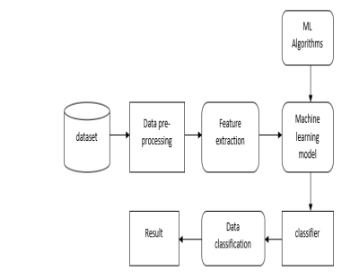
METHODOLOGY

Slide 8
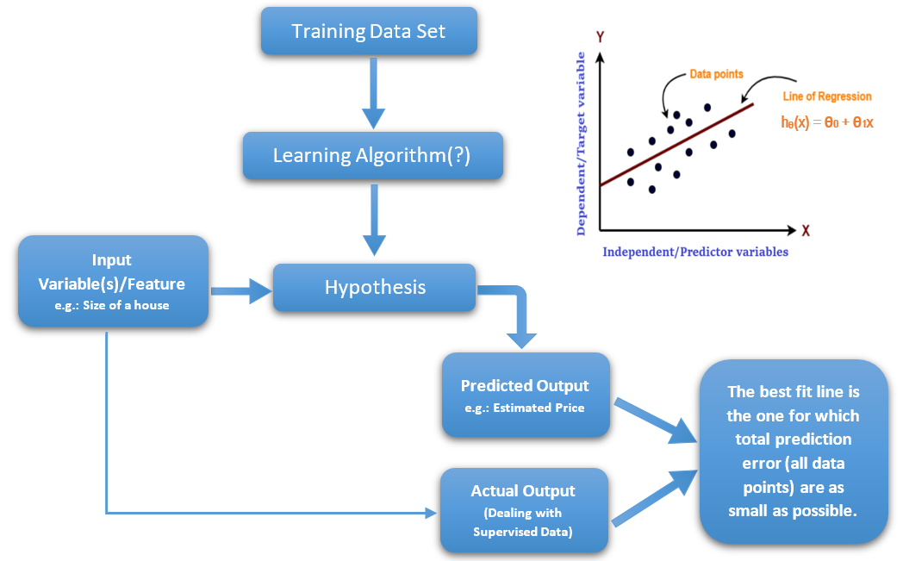
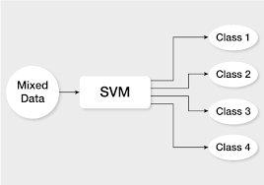
ALGORITHMS AND ALOGRITHM JUSTIFICATION
LINEAR REGRESSION
DESCISION TREES
SVM
SUPPORT VECTOR MACHINE
LINEAR REGRESSION

Slide 9
COMPARTIVE STUDY
Linear Regression is a regression model, meaning, it’ll take features and predict a continuous output, eg : stock price, salary etc. Linear regression as the name says, finds a linear curve solution to every problem.
Advantages :
Easy and simple implementation.
Space complex solution.
Fast training.
Value of θ coefficients gives an assumption of feature significance
Decision tree is a tree based algorithm used to solve regression and classification problems. An inverted tree is framed which is branched off from a homogeneous probability distributed root node, to highly heterogeneous leaf nodes, for deriving the output. Regression trees are used for dependent variable with continuous values and classification trees are used for dependent variable with discrete values.
Support Vector Machine or SVM is one of the most popular Supervised Learning algorithms, which is used for Classification as well as Regression problems. However, primarily, it is used for Classification problems in Machine Learning.
The goal of the SVM algorithm is to create the best line or decision boundary that can segregate n-dimensional space into classes so that we can easily put the new data point in the correct category in the future. This best decision boundary is called a hyperplane.

Slide 10
MACHINE LEARNING ALGORITHM
LINEAR REGRESSION
ELASTIC NET REGRESSION
SVM

Slide 11
RESULTS
DATA COLLECTION :- Data used in this paper is a set of student details in the school records. This step is concerned with selecting the subset of all available data that you will be working with. ML problems start with data preferably, lots of data (examples or observations) for which you already know the target answer. Data for which you already know the target answer is called labelled data.
DATA PRE-PROCESSING Organize your selected data by formatting, cleaning and sampling from it. Three common data pre-processing steps are:
1. Formatting 2. Cleaning 3. Sampling

